Slide 1
Sentiment Analysis in Twitter
SemEval-2016 Task 4
Boštjan Bohte, Nikola Balaban

Slide 2
Introduction
Social media are commonly used to share any thoughts and opinions about anything in the surrounding world
SamEval task is active since 2013 and it attract over 40+ participant teams

Slide 3
Data
datasets with annotated tweets
gathered in a way, that express sentiment about popular topics

Slide 4
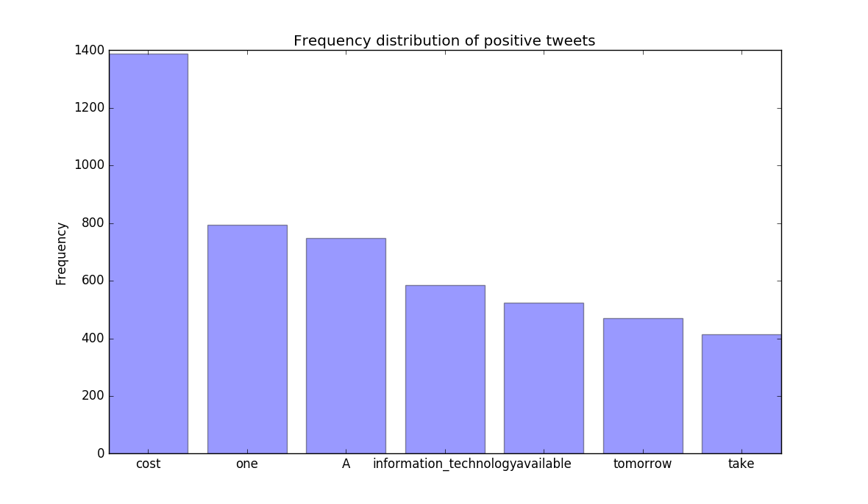
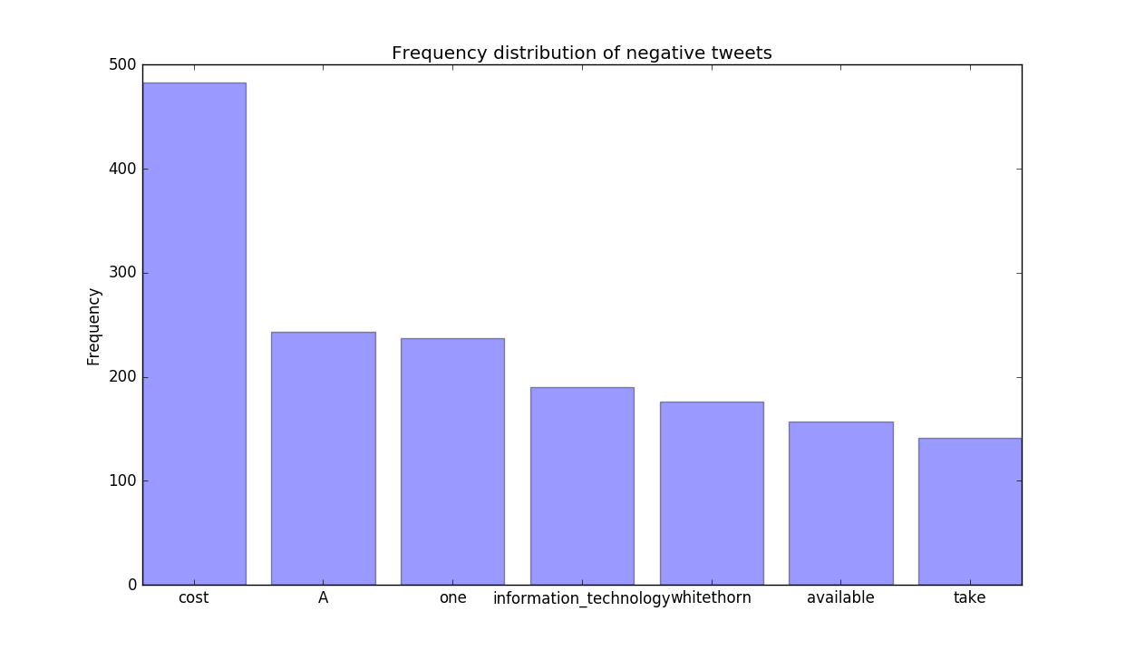
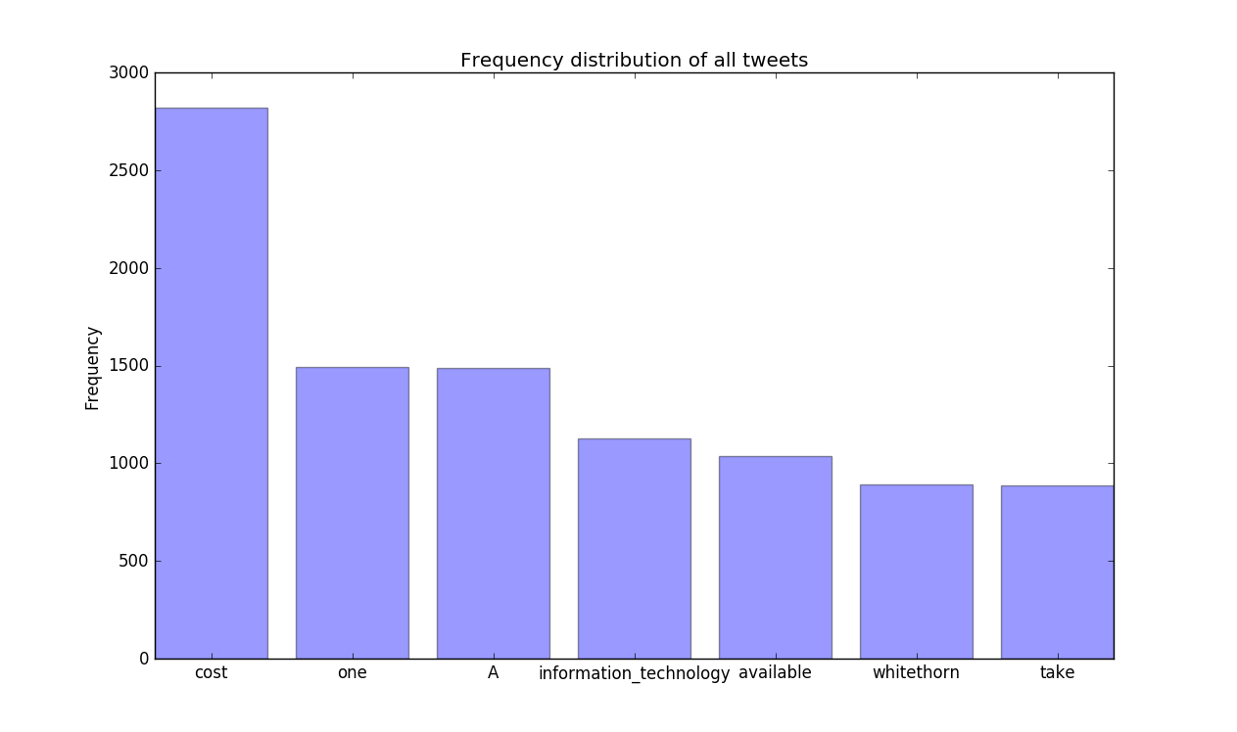
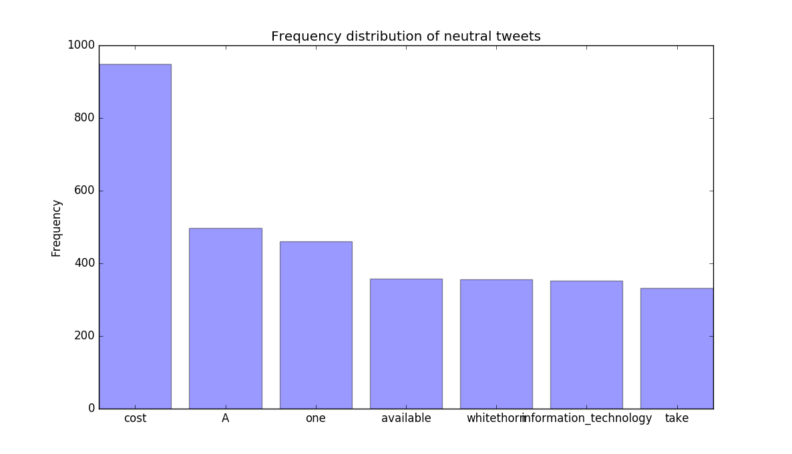
Data

Slide 5
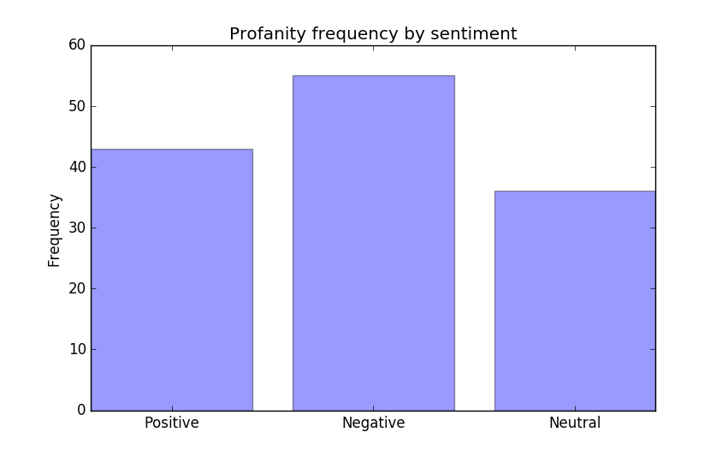
Data
Emoticons impact:
Acc.(no emoji) = 38.93 %
Acc.(emoji) = 38.93 %
Acc.(emoji+) = 38.98 %

Slide 6

Subtask A: Message polarity classification
For TF-IDF we got accuracy of 38.98 % and $F_{1}^{PN}=0.35$
For random forest classifier the result may vary but the end accuracy is 33.95 % and $F_{1}^{PN}=0.26$

Slide 7
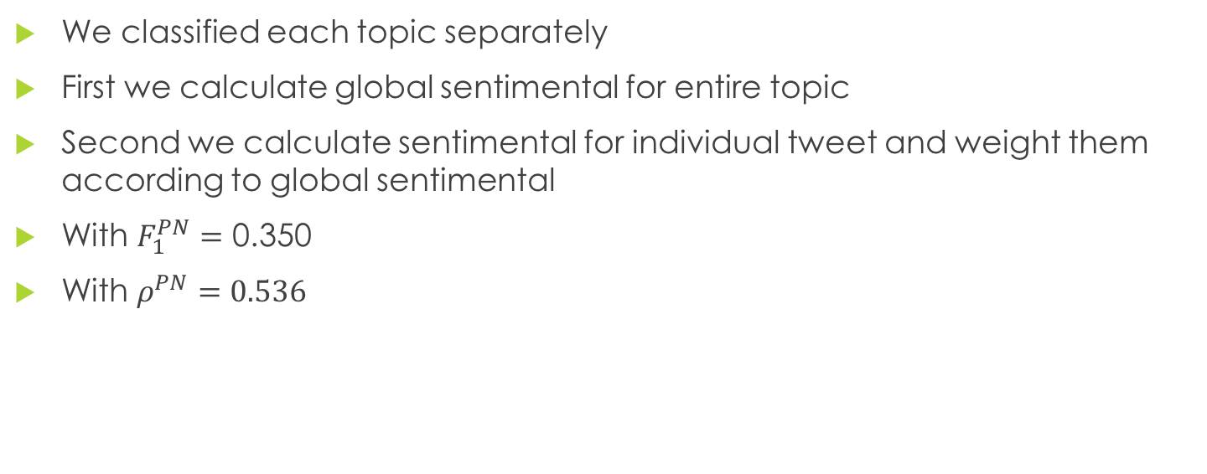
Subtask B: Tweet classification according to a two-point scale
We classified each topic separately
First we calculate global sentimental for entire topic
Second we calculate sentimental for individual tweet and weight them according to global sentimental
With $F_{1}^{PN}=\text{0.350}$
With $ρ^{PN}=0.536$

Slide 8

Subtask C: Tweet classification according to a five-point scale
Same procedure as for Subtask B, but with 5-point scale
For evaluation we use macro-averaged mean absolute error
$MAE^{M}\left(h, Te\right)=0.985$

Slide 9
Conclusion
Data and tools
Data preprocessing
Understanding of irony and jokes

